Slide 1
Basic - Introduction
Open Shortest Path First - uses Dijkstra’s Algorithm (SPF).
IGP (Interior Gateway Protocol) - route traffic within a single AS (Autonomous System).
Standard Protocol – Cisco/Non-Cisco devices.
Link-State Protocol – sent LSAs (Link-State Advertisement) periodically.
Thus, convergence is Fast (40 seconds).
Protocol number 89.
AD (Administrative Distance) value 110.
Multicast address 224.0.0.5 for normal communication and 224.0.0.6 for update to DR/BDR (Designated Router/Backup Designated Router).
Supports equal Load balancing.
No automatic summarization.
Multiple areas.
Supports CIDR (Classless Inter-Domain Routing).
No limit for number of Hops (routers) connected.
Notes:
Dijkstra’s Algorithm: Dijkstra's algorithm, named after Dutch computer scientist Edsger W. Dijkstra, is a widely used algorithm in computer science and mathematics for finding the shortest path between nodes in a weighted graph. It is particularly useful in various applications, such as network routing, GPS navigation, and optimizing transportation or communication networks.
AS: An AS is typically operated by a single organization, such as an Internet Service Provider (ISP), a large corporation, a data center, or a university. This entity has control over the routing policies and decisions within its AS.
Link-State: In a Link-State Routing Protocol, each router in the network maintains a database that contains information about the state of its directly connected links. This information includes the status (up or down) and the cost (typically a metric reflecting the link's quality or capacity) of each link. This data is referred to as the router's link-state information. Routers running a Link-State Routing Protocol periodically exchange their link-state information with neighboring routers. This exchange ensures that all routers within the network have consistent and up-to-date information about the state of all links in the network. With complete and synchronized link-state information, each router independently calculates the shortest path to all destinations within the network. Common algorithms like Dijkstra's algorithm are used for this purpose. The result is a routing table that contains the best path (shortest path) to reach each destination.
Protocol 89: In networking, the protocol number 89 is associated with OSPF (Open Shortest Path First) when referring to the Internet Protocol (IP) protocol version 4 (IPv4). This number is used to identify the OSPF protocol at the transport layer of the OSI model. Specifically, it's used in the IP header's "Protocol" field to indicate that the packet is carrying OSPF information.
AD: Administrative Distance is a metric used to assign a preference or trustworthiness value to different routing protocols or information sources in order to help a router determine which route to choose when it receives routing updates for the same destination from multiple sources. The route with the lowest Administrative Distance is considered the most preferred and will be chosen for routing.
DR: Rather than having all routers form adjacencies and exchange OSPF routing information with every other router in the segment, which can be inefficient and lead to unnecessary traffic, OSPF elects a single router as the Designated Router (DR) for that segment. The DR is responsible for representing the entire segment to the rest of the OSPF domain. The DR also sends and receives LSAs (Link-State Advertisements) on behalf of the routers in the segment.
BDR: The BDR is the router with the second-highest priority (after the DR) in a multi-access network segment. The BDR is in a standby or backup role, ready to take over as the DR if the current DR fails or becomes unreachable. Having a BDR ensures network continuity and rapid failover in case the DR goes down.

Slide 2
Basic – Packet Header Format
Version: OSPFv2 for IPv4.
Type: OSPF packet type from 1 to 5. Such as: Hello, DD, LSR, LSU, LSAck.
Packet Length: Total length of the packet in bytes including header.
Router ID: Advertising router ID.
Area ID: To which the OSPF enabled interface belongs.
Checksum: To perform error checking.
AuType: Authentication type ranging from 0 to 2 respectively non-authentication, simple (plaintext) authentication, and MD5 authentication.
Authentication: Data used for authentication.
IP Header OSPF Packet Header OSPF Data
0 7 15 31
Version Type Packet Length
Router ID
Area ID
24 bytes
Checksum AuType
Authentication
Authentication

Slide 3
Basic – How it works!
OSPF works in three steps mainly:
Becoming Neighbors: OSPF routers discover and establish neighbor relationships with other OSPF routers on the same network segment by sending Hello packets. To see the neighbor table, type this command in privileged EXEC mode: ‘show ip ospf neighbor’
Exchanging Database: OSPF routers exchange Link-State Advertisements (LSAs) to create and maintain a synchronized link-state database. LSAs contain information about the routers, links, and subnets within the OSPF area. To see the database table, type this command in privileged EXEC mode: ‘show ip ospf database’
Calculating Best Route: OSPF use Dijkstra's algorithm to calculate the shortest path tree (SPF tree). The SPF tree represents the best paths to reach all destinations within the OSPF area. To see the routing table, type this command in privileged EXEC mode: ‘show ip route’

Slide 4

Basic – Becoming Neighbors
OSPF process stars with a Hello message. There are 3 states in becoming neighbors:
Hello! My RID: 1.1.1.1
Neighbors: 224.0.0.5 Multicast
Down
Down
Router ID: 1.1.1.1
Router ID: 2.2.2.2
Hello! My RID: 2.2.2.2
Neighbors: 1.1.1.1 Unicast
Down
Init
Router ID: 1.1.1.1
Router ID: 2.2.2.2
Hello! My RID: 1.1.1.1
Neighbors: 2.2.2.2 Unicast
2-Way
Init
Router ID: 1.1.1.1
Router ID: 2.2.2.2
2-Way
2-Way
Router ID: 1.1.1.1
Router ID: 2.2.2.2
Notes:
Down: Routers have not yet established any OSPF neighbor relationship. In this state, routers are unaware of each other's presence on the network. Routers send multicast hello message in this state.
Init: This state indicates that hello packet have been received from another router, but bidirectional communication has not been established.
2-Way: Bidirectional communication has been established and the routers are neighbors. If DR and BDR is needed, this election occurs in this state.

Slide 5
Basic – Becoming Neighbors
Router ID: A 32 bit unique number. OSPF router is identified using same ID in all directions. It is selected in following cascading selection:
Manually assigned. ‘Router(config)# router ospf 1’ ‘Router(config-router)# router-id 1.1.1.1’
Highest ‘up’ status loopback interface IP address.
Highest ‘up’ status physical interface IP address.
Conditions: There are some requirements to match to become neighbors:
1. Hello interval 5. Subnet mask
2. Dead interval 6. Authentication
3. OSPF area ID 7. Stub area flag
4. Subnet number 8. Unique router ID
To reset the Router ID, use following command in privileged EXEC mode:
‘Router# clear ip ospf process’
Notes:
Loopback: A loopback interface, often referred to simply as "loopback," is a virtual network interface on a computer or networking device. It is a special-purpose interface used primarily for internal communication within the device itself.

Slide 6
Basic – Packet Type 1 (Hello)
Network Mask: The netmask of the interface.
Hello Interval: The default is 10 seconds for broadcast and point-to point networks and 30 seconds for NBMA (Non-broadcast Multi-access).
Options: Indicating the various OSPF router capability, such as whether stub areas are supported in the Options field.
Router Priority: This is a number from 0 to 255, which defaults to 1. The router with the highest value will become the designated router. If the Priority is set to 0, the router does not participate in the DR/BDR selection.
Dead Interval: Time before declaring a silent router down. It is four times hello interval.
DR: IP address of the Designated Router.
BDR: IP address of the Backup Designated Router.
Neighbors: Router ID of the neighbor routers.
IP Header OSPF Header OSPF Hello Packet
0 7 15 31
Network Mask
Hello Interval Options Router Priority
Dead Interval
Designated Router (DR)
Backup Designated Router
Neighbor
…
***Initial DR, BDR & Neighbors are “0.0.0.0”
Notes:
NBMA: It refers to a type of network topology or technology commonly found in computer networking. In an NBMA network, multiple devices or nodes are connected to a common network segment or medium, but unlike a broadcast network (such as Ethernet), NBMA networks do not support the automatic broadcasting of data to all nodes on the network. Instead, communication in an NBMA network typically requires explicit addressing.

Slide 7
Basic – Exchanging Database
After becoming neighbors, routers starts to flood the summary information of LSAs. There are some states to become adjacent router:
I will start exchange! My RID: 1.1.1.1
Unicast
Exstart
Exstart
Router ID: 1.1.1.1
Router ID: 2.2.2.2
No, I will start exchange!
My RID: 2.2.2.2 Unicast
Exstart
Exstart
Router ID: 1.1.1.1
Router ID: 2.2.2.2
Here is the summary of my DB!
My RID: 1.1.1.1
DD Packets
Exchange
Exchange
Router ID: 1.1.1.1
Router ID: 2.2.2.2
DD Packets
Here is the summary of my DB!
My RID: 2.2.2.2
Exchange
Exchange
Router ID: 1.1.1.1
Router ID: 2.2.2.2
Notes:
Exstart: This is the first step in forming the adjacencies. Routers identify which router will be the master and slave for the LSDB synchronization.
Exchange: After two routers decides to exchange databases, the do not simply send the content of the full database, just the summary information. During this state, routers are exchanging link states by using Database Description (DD) packets.

Slide 8
Basic – Packet Type 2 (DD-Database Descriptor)
Interface MTU: largest IP datagram in bytes that the interface can send without fragmentation. If the MTU sizes do not match, the neighbor will get stuck in the ExStart state.
Options: Indicate the various capabilities of the OSPF router.
5 bits following options are fixed to “00000”.
I: The Initial bit, which is set to 1 if the packet is the first DD packet. It is set to 0 if not.
M: The More bit, which is set to 0 if the packet is the last DD packet. It is set to 1 if more DD packets are to follow.
M/S: The master/Slave bit. M/S-bit=1 indicates that the router is the Master router, otherwise the router is the Slave router.
DD Sequence Number: Ensures that DD packets are received; the router that serves as the Master determines a unique initial value and increments the sequence number in subsequent DD packet exchanges.
LSA Header: A list of LSA headers for all LSAs in the LSDB of the router generating the DD packet.
IP Header OSPF Header OSPF DD Packet
0 7 15 31
M
S
Interface MTU Options 0 0 0 0 0 I M
DD Sequence Number
LSA Header
…
…
LSA Header

Slide 9
Basic – Calculating Best Route
Each router can check which LSAs it already has and then ask the router for only remaining LSAs. After the link-state databases of the neighbors are fully synchronized, they become full adjacent and apply algorithm analyzing the LSDB.
I need complete entry for network ‘this’ My RID: 1.1.1.1
LSR Packets
Loading
Loading
Router ID: 1.1.1.1
Router ID: 2.2.2.2
LSU Packets
Here is complete entry for network ‘this’
My RID: 2.2.2.2
Loading
Loading
Router ID: 1.1.1.1
Router ID: 2.2.2.2
LSAck Packets
Thanks for the information!
LSAck Packets
Full
Full
Router ID: 1.1.1.1
Router ID: 2.2.2.2
There is another state named “Attempt” state. It is only seen in NBMA (Non-Broadcast Multi Access) links. In NMBA, we have to manually configure the neighbor’s IP because it doesn’t support multicast. Then, hello packets are sent unicast to manually configured neighbor IP.

Slide 10
Basic – Packet Type 3 (LSR-Link State Request)
Link-State Type: It is a number (1-7) that indicates the type of LSA.
LSA type code 1 - Router LSA
LSA type code 2 - Network LSA
LSA type code 3 - Network Summary LSA
LSA type code 4 - ASBR Summary LSA
LSA type code 5 - AS External LSA
LSA type code 7 - NSSA External LSA
Link-State ID: The Link State ID is contained in the LSA header, and what the Link State ID contains depends on the type of LSA. For,
LSA type 1 - the router ID that generated the LSA.
LSA type 2 - the IP address of the DR.
LSA type 3 - the network address of another area generated by ABRs (inter-area routes).
LSA type 4 – the network address of another area (routes to ASBRs).
LSA type 5 - the router ID of the ASBR advertising the external routes.
LSA type 7 - the ABR in the NSSA (Not So Stubby Area) translates type 7 LSAs into Type 5 LSAs before sending them to other OSPF areas.
Advertising Router: The router ID of the router that generated the LSA.
IP Header OSPF Header OSPF LSR Packet
0 7 15 31
Link-State Type
Link-State ID
Advertising Router
…
Link-State Type
Link-State ID
Advertising Router

Slide 11
Basic – Packet Type 4 (LSU-Link State Update) & Type 5 (LSAck)
IP Header OSPF Header OSPF LSU Packet
IP Header OSPF Header OSPF LSAck Packet
0 7 15 31
0 7 15 31
Number of LSAs
LSA Header
LSAs
…
…
LSA Header
Number of LSAs: the number of LSAs contained in the LSU packet.
LSAs: LSAs to be advertised in LSU packets; multiple LSAs can be included and advertised in a single LSU packet. The LSA consists of LSA header and LSA data.
LSA Header: A list of received LSA headers; a single LSAck packet can contain multiple LSA headers.

Slide 12
Basic – LSA Flooding
R5 LSA
R3
R5 LSA
R5 LSA
R5 LSA
R1
R2
R5
R5 LSA
R5 LSA
R4

Slide 13
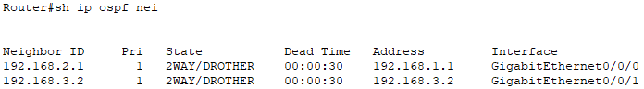
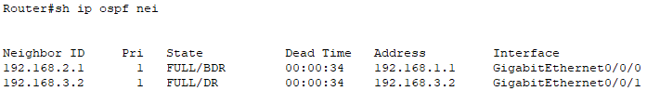
Basic – Maintaining Updates
Maintaining Neighbors and the LSDB-
Incremental updates (whenever there is a change).
Hello packets are sent periodically every 10 seconds and Dead time is 40 seconds.
Convergence rate is fast (40 seconds).
Periodic Updates-
Each router re-flood the LSA every 30 minutes by default even if no changes occur.
But the network is not overloaded with flooding LSAs. Why? Because, each LSA has e separate timer, based on when the LSA was created.

Slide 14
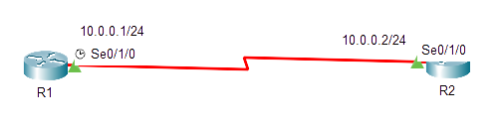
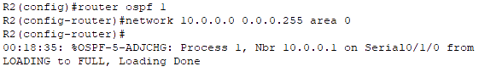
Basic – Configurations
Process ID: 32 bit Process ID is a number used to identify an OSPF routing process on the router. Multiple OSPF processes can be started on the same router. This process ID is locally significant. Its range is 0 to 65535.
Network ID: Advertising network’s IP address.
Wildcard Mask: Tell the IOS which portion of the bits to match or ignore.
Decimal 0 (Min): The router must compare this octet as normal .
Decimal 255 (Max): The router ignores this octet, considering it to already match.
Area ID: OSPF area number in which this interface/network will exist.
R1(config)# router ospf <process ID>
R1(config-router)# network <network ID> <wildcard mask> area <area ID>

Slide 15
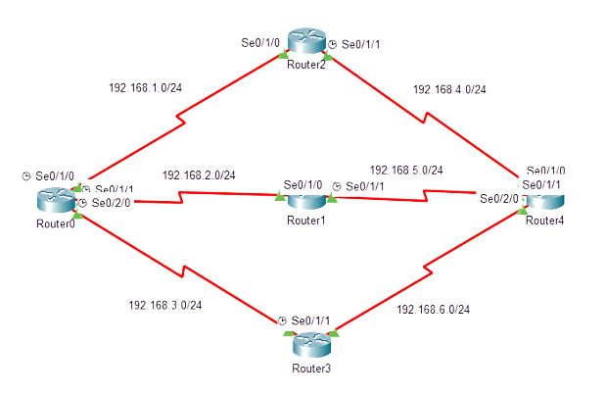
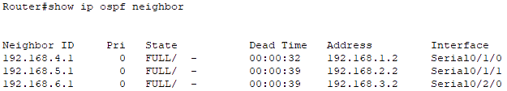
Basic – Neighbor Table
Neighbor ID: The router ID of the neighbor.
Pri: The priority value is used in the OSPF neighbor election process. It determines the likelihood of a router becoming the Designated Router (DR) or Backup Designated Router (BDR) on a multi-access network segment.
State: The current status of neighborship.
Dead Time: time interval within which OSPF routers expect to receive Hello packets from their neighbors, if not received it will go to down state.
Address: IP address of the neighbor.
Interface: the specific interface through which the OSPF neighbor is reachable.
Table-1: Neighbor Table

Slide 16
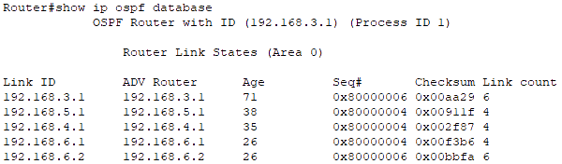
Basic – Database Table
OSPF Database Table is called LSDB.
Each Entry in LSDB is known as LSA.
Seq#: Each LSA has a sequence number associated with it, which helps routers track the most recent version of the LSA. If a router receives an LSA with a higher sequence number, it indicates a more recent update.
Checksum: A checksum value calculated for the LSA's contents. Routers use this value to verify the integrity of the LSA during transmission.
Link count: The number of individual links or entries within the LSA. The number of links can vary depending on the LS type.
Table-2: Database Table
Link ID: What the Link State ID contains depends on the type of LSA.
ADV Router: IP address of the OSPF router that originated or advertised the LSA.
Age: indicates how long (in seconds) ago the LSA was originally generated by the advertising router. It helps routers determine the freshness of the routing information.

Slide 17
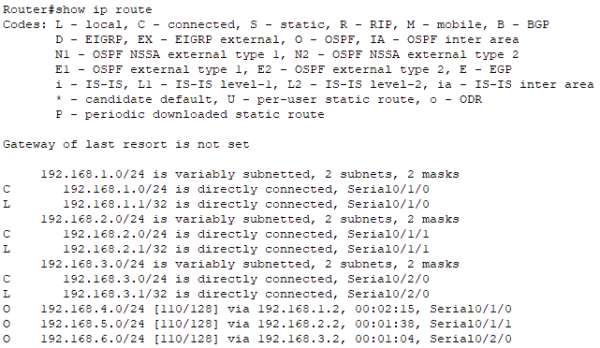
Basic – Route Table
Destination Network IP address with its Subnet Mask (CIDR) value.
Administrative Distance and Cost (Metric) value (lowest).
Next Hop ID Address
Existing Route duration time.
Interface through which traffic should be sent to reach the destination network.
Table-3: Route Table

Slide 18
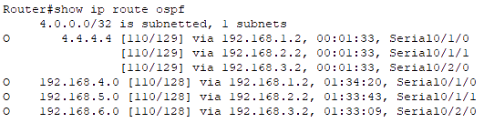
Basic – OSPF Route Table
In Route Table, we only get the best route to get to the destination network. But in OSPF Route Table, we get every possible route found to get to the destination network by OSPF routing protocol with their Destination IP Address (with CIDR value), Administrative Distance, Cost (Metric), Next Hop IP Address, Existing Route Duration Time and Source Interface IP Address.
Table-4: OSPF Route Table

Slide 19
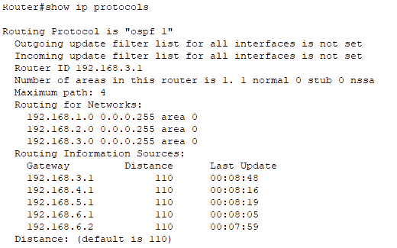
Basic – Protocols Table
In Route Table, we only get the best route to get to the destination network. But in OSPF Route Table, we get every possible route found to get to the destination network by OSPF routing protocol with their Destination IP Address (with CIDR value), Administrative Distance, Cost (Metric), Next Hop IP Address, Existing Route Duration Time and Source Interface IP Address.
Table-5: Protocols Table

Slide 20
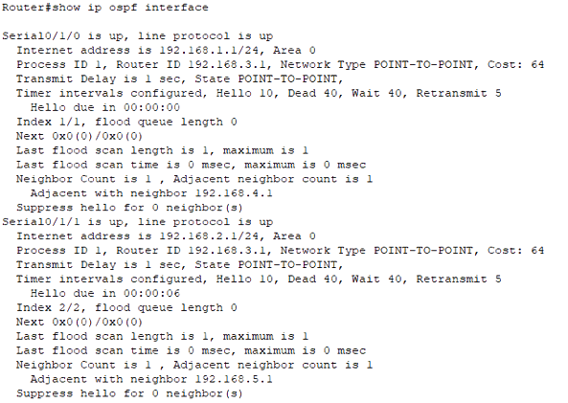
Basic – Interfaces
This command provides details about OSPF-enabled interfaces, including their state, IP addresses, area assignments, hello time, dead time, waiting time, process ID and many more.
To see summary of OSPF interfaces apply this command-
‘Router# show ip ospf interface brief’

Slide 21
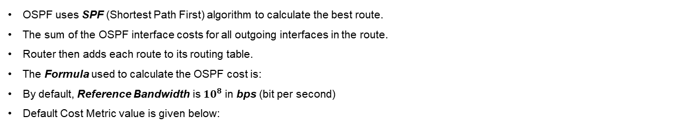

Basic – Cost Metric
OSPF uses SPF (Shortest Path First) algorithm to calculate the best route.
The sum of the OSPF interface costs for all outgoing interfaces in the route.
Router then adds each route to its routing table.
The Formula used to calculate the OSPF cost is:
By default, Reference Bandwidth is ${10}^{8}$ in bps (bit per second)
Default Cost Metric value is given below:
Cost $=\frac{Reference Bandwidth}{Interface Bandwidth}$
Interface | Interface Default Bandwidth (Kbps) | Formula (Kbps) | OSPF Cost
Serial | 1544 | 100,000/1544 | 64
Ethernet | 10,000 | 100,000/10,000 | 10
Fast Ethernet | 100,000 | 100,000/100,000 | 1
Gigabit Ethernet | 1,000,000 | 100,000/1,000,000 | 1
10 Gigabit Ethernet | 10,000,000 | 100,000/10,000,000 | 1
100 Gigabit Ethernet | 100,000,000 | 100,000/100,000,000 | 1
Notes:
Let, my pc connected interface can support 1000mbps, but my ISP gave me bandwidth of 15mbps. This means, maximum data transmission through this cable will be 15mbps my ISP gave me, but it can support upto 1000mbps.

Slide 22
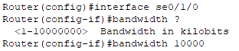
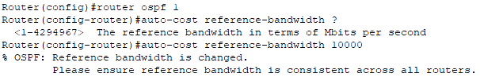
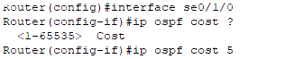
Basic – Cost Metric
There are three ways to change interface cost in cisco routers:
Changing Interface Bandwidth: It will change the total cost metric of interface by using the interface subcommand- ‘bandwidth <value>’
Changing Default Reference Bandwidth: Any interface with an interface bandwidth of 100 Mbps or faster ties with a calculated OSPF cost of 1 which is a limitation. It is probably not the right basis for choosing routes. It can be changed by using this command- ‘auto-cost reference-bandwidth <value>’
Changing Cost Manually: Manually setting the cost will replace the calculated cost metric. Thus the calculated best route might also change. We can change the cost manually using the interface subcommand- ‘ip ospf cost <value>’
***Cisco recommends making the OSPF reference bandwidth settings the same on all OSPF routers in an Enterprise Network.
Notes:
Cisco recommends making the OSPF reference bandwidth setting the same on all OSPF routers in an enterprise network because it helps to ensure that all routers calculate the OSPF cost for each link in the same way. Else, the OSPF cost for a link will also be different, which can lead to routing loops and other problems. It can also lead to suboptimal routing. If there is a problem with OSPF, it can be difficult to troubleshoot which can make it difficult to identify the root cause of the problem.

Slide 23
Basic – OSPF Area
Single Area Limitations:
Larger topology requires more memory on router.
Too many LSAs may cause network overload.
Take more CPU time & resources to run SPF algorithm.
A single interface status change anywhere forces every router to run SPF again.
Convergence time becomes very slow.
OSPF Multiple Area:
Multiple area allows to logically group set of routers in one area.
It will break one large LSDB into several smaller LSDBs.
Minimizes the CPU & memory resources.
Convergence becomes fast.
Any changes are restricted, LSA advertised in the particular area only.
OSPF area range 0 to 4294967295.
OSPF Multiple Area Design Rules:
In each area, recommended number of router is less than 30 to 50.
Two or more area must have at least one area named ‘area 0’ which is called the backbone area.
All the non-backbone areas must connect to area 0. Else it cannot advertise its networks in other areas by default.
There must be at least one ABR (Area Border Router) connecting two or more areas.
Interfaces of both routers facing must be in the same area.

Slide 24
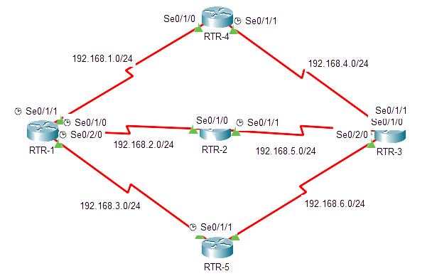
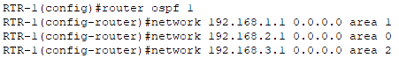
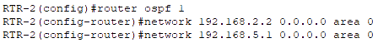
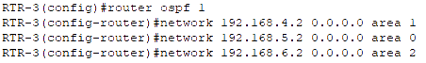
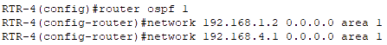
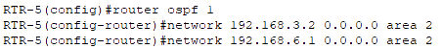
Basic – OSPF Multiple Area Configuration
ABR
ABR
Area 1
Area 0
Area 2
***Router doesn’t belong to any area, only router’s interfaces belong to specific areas.

Slide 25
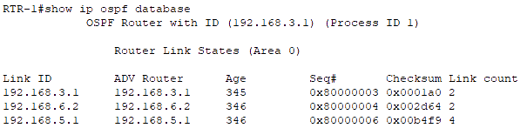
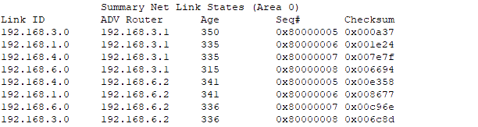
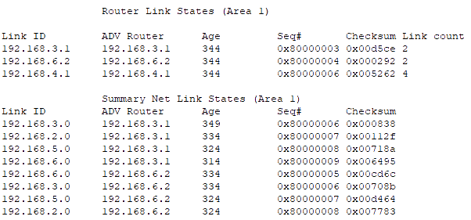
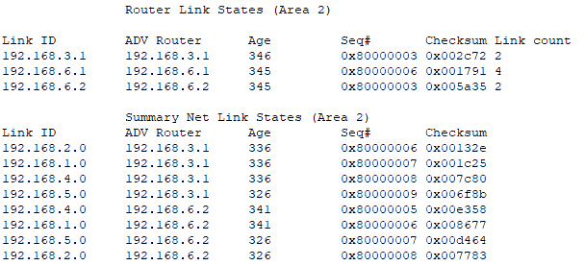
Basic – OSPF Multiple Area Database Tables
1
2
3
4
***OSPF Areas create a 2-Tier Hierarchy:
Area 0 – Top of Hierarchy – Backbone Area (Assures loop free area topologies, also Hub and Spike design)
Area # – All other Areas

Slide 26
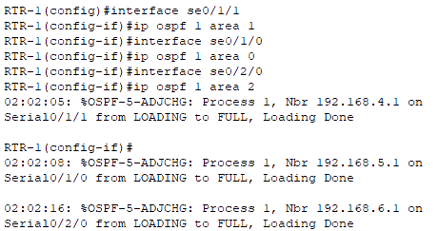
Basic – OSPFv2 Interface Subcommands
We can use Interface Subcommands instead of using the network command in global config mode to advertise OSPF- ‘Router(config)# interface <interface name>’ ‘Router(config-if)# ip ospf <process ID> area <area no>’
It can also be used in sub-interfaces using these commands- ‘Router(config)# interface g0/0.1’ ‘Router(config-if)# ip ospf 1 area 0’ ‘Router(config-if)# interface g0/0.2’ ‘Router(config-if)# ip ospf 1 area 0’ ‘Router(config-if)# interface g0/0’ ‘Router(config-if)# ip ospf 1 area 0’
Notes:
In Sikandar Shaik’s video about ospf interface subcommands, he said that if we advertise OSPF network as usual, it will show something like “Attached via Network Statement” and if we use interface subcommands, it will show something like “Attached via Interface Enable” in show ip ospf interface <interface name> command. There will be also difference in output in using show ip protocols command. But these changes haven’t been shown in cisco packet tracer simulator, so not sure about it happends still now or not in real devices.

Slide 27
Basic – Types of Routers
IR (Internal Router): IRs are routers that have all their interfaces in the same OSPF area. They don’t have interfaces in multiple OSPF areas. They maintain the OSPF Database for their area and participate in the calculation of the best routes within the area.
ABR (Area Border Router): An ABR is a router that is connected to two or more OSPF areas. They maintain an LSDB for each area and serve as a gateway, thus summarize routes from one area to another, reducing the size of the OSPF database in each area.
ASBR (Autonomous System Border Router): Connect the OSPF routing domain to external networks or other routing domains, such as those using different routing protocols. ASBRs redistribute external routes into the OSPF routing domain and vice versa.
BR (Backbone Router): Backbone Routers are routers that have at least one interface in the OSPF backbone area (Area 0). Backbone Routers are crucial for interconnecting OSPF areas.
DR (Designated Router): Elected on multi-access network segments (Ethernet) to reduce OSPF traffic and adjacencies. The DR is responsible for generating network-specific LSAs (Type 2 LSAs) & forwarding OSPF updates to other routers on the same segment.
BDR (Backup Designated Router): The BDR monitors the DR and quickly assumes the DR role if the DR becomes unavailable. This ensures redundancy and stability on multi-access segments.
VLR (Virtual Link Router): Virtual Routers are routers that establish virtual links to connect OSPF areas when physical connectivity to the backbone area (Area 0) is not possible. They allow routers in non-backbone areas to reach the backbone area indirectly.
SR (Stub Router): A stub router is a router that is connected to only one OSPF area and does not exchange routing information with other areas. Stub routers are typically used in small networks.

Slide 28
Basic – Network Types
There are mainly three types of OSPF network-
OSPF
1. Point-to-Point
2. Broadcast Multi Access
3. NBMA (Non Broadcast Multi Access
A point-to-point network is a network where two routers are directly connected to each other. This type of network is typically used for serial links by default.
A broadcast network is a network where all routers are connected to a single broadcast domain. This type of network is typically used for Ethernet networks by default.
An NBMA network is a network where multiple routers are connected to a shared medium, but they don’t have broadcast capabilities and this type of network is typically used for Frame Relay & ATM networks.

Slide 29
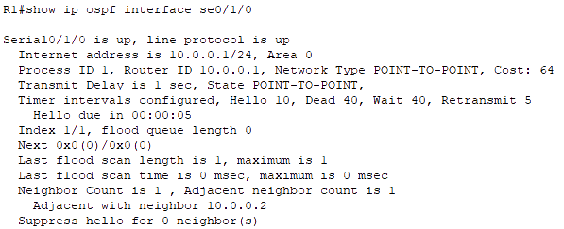
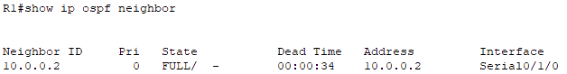
Basic – Point-to-Point Network
A single point-to-point link is a single pair of router.
Does not support the ability to add a third router to the link.
Usually a serial interface running either PPP or HDLC.
May also be a point-to-point sub-interface running Frame Relay or ATM.
No election of DR or BDR is required.
OSPF packets are sent using multicast 224.0.0.5.
OSPF auto-detects this interface type.
Point-to-Point over Ethernet Links:
Most of the WAN Ethernet connections can be P2P. Like- Ethernet Private Wire Service, Ethernet Line, etc. In this scenario, Ethernet DR/BDR adds a extra convergence time. P2P over ethernet links can be done using the commands- ‘R1(config)# interface se0/1/0’
‘R1(config-if)# ip ospf network point-to-point’

Slide 30
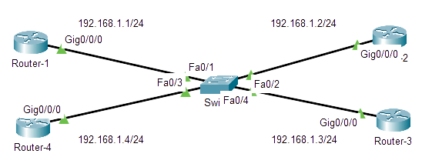
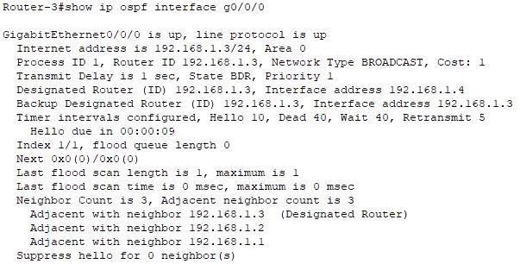
Basic – Broadcast Network
OSPF by default uses Broadcast network type on all types of Ethernet interfaces.
In broadcast multi-access networks there is two challenges-
Multiple adjacencies.
Flooding of LSAs.
These challenges are solved by electing DR and BDR.
All neighbor routers form full adjacencies with the DR and BDR only.
The DROTHER routers will never update other routers in the network.
DROTHER DR, use multicast 224.0.0.6 DR DROTHER, use multicast 224.0.0.5.
DROTHER
DROTHER
DR
BDR
Notes:
Multiple adjacencies- Routers from neighbors all routers (same broadcast domain).
Flooding of LSAs- Possibility of the creating multiple LSU loops.

Slide 31
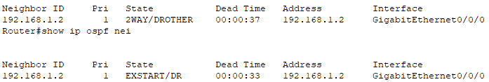
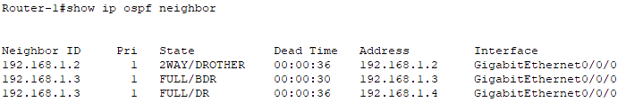
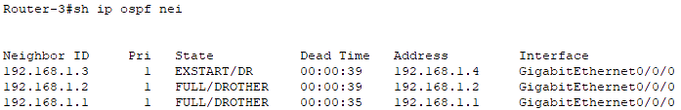
Basic – DR and BDR Election
The router having highest priority will become DR.
The router with second-highest priority is BDR.
The default priority value is 1.
The range of priority value is 0-255.
In case of a tie,
Router with highest router ID is DR.
Second highest router ID becomes BDR.
This DR/BDR election occurs during OSPF neighborship, specifically during the last phase of 2-Way neighbor state and just before the Exstart state.
If router priority is 0, it cannot become DR/BDR.
DR/BDR election is not preemtive.
If a new router is added within the topology with a better priority value after DR/BDR election, it does not preempt the existing DR and BDR until the current DR and BDR fail.
DR BDR – EXSTART DR/BDR DROTHER – FULL DROTHER DROTHER – 2-WAY
To change the priority value manually using the command- ‘Router(config)# interface g0/0/0’ ‘Router(config-if)# ip ospf priority <priority value>’
Notes:
Multiple adjacencies- Routers from neighbors all routers (same broadcast domain).
Flooding of LSAs- Possibility of the creating multiple LSU loops.

Slide 32
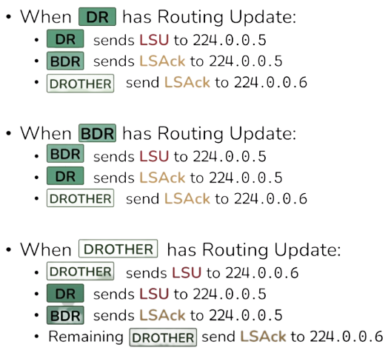
Basic – DR/BDR/DROTHER & OSPF Show Commands
‘show ip protocols’
‘show ip ospf interface’
Show ip ospf interface ?’
‘show ip ospf interface brief’
‘show ip neighbors’
‘show ip ospf rib’
‘show ip route’
‘show ip route ospf’
‘show ip ospf’
‘show ip ospf database’
‘show ip ospf database router (routerID)’
‘show ip ospf database network (networkID)’
‘show ip ospf database ?’
‘debug ip ospf ?’

Slide 33
Basic – OSPF Passive Interface
Passive Interface is used to prevent OSPF interfaces from sending OSPF Hello packets.
Thus, the passive interface does not participate in OSPF neighborship.
Instead, these interfaces only listen to OSPF updates and do not actively advertise OSPF routing information.
It can be used in Stub areas where no further OSPF routing information is needed.
It can be used on interfaces connected to external networks, such as the internet or untrusted networks.
It can be used to minimize OSPF traffic on specific links without affecting overall network functionality.
To make one or few interfaces as passive interface use these commands-
‘Router(config)# router ospf <process ID>’
‘Router(config-router)# passive-interface <interface name>’
In scenarios where multiple interfaces are need to make as passive interfaces excluding few interfaces, use these commands-
‘Router(config)# router ospf <process ID>’
‘Router(config-router)# passive-interface default’
‘Router(config-router)# no passive-interface <excluded interface name>’
The ‘passive-interface default’ command make all the interfaces as passive interface.

Slide 34
Advanced – LSA Types
LSA stands for Link State Advertisements. They are used to exchange information about the network's topology.
There are total 11 types of LSAs-
Type 1 Router LSA: Advertises the router itself, directly connected interface addresses, link states & costs, and neighbor routers.
Type 2 Network LSA: Advertises the networks that the router is connected to, as well as the routers that are connected to those networks. Network LSA is generated by DR on multi-access networks, and the LSA which DR get from DROTHERs area LSA type 1.
Type 3 Summary LSA: Advertises a summary of the routes in an area to other areas, generated by ABRs.
Type 4 ASBR Summary LSA: Advertises a summary of the routes to external ASs to other areas, generated by ABRs.
Type 5 AS External LSA: Advertises routes to external ASs, generated by ASBRs.
Type 6 Multicast OSPFv3 LSA: Advertises the multicast groups that the router is a member of, used in OSPFv3 (IPv6 networks).
Type 7 NSSA External LSA: Advertises routes to external networks in an NSSA.
Type 8 External Attributes LSA: Advertises additional information about external routes, such as the next hop address and the metric.
Type 9 Opaque LSA: Advertises prefixes within an OSPFv3 area, used for future extensions or proprietary information.
Type 10 Opaque LSA: Similar purposes as Type 9, but they serve as a distinct type for differentiating information.
Type 11 Opaque LSA: Similar purposes as Type 9 and type 10, used for additional custom extensions or proprietary data.
***Type 1 & 2 are used for same area (O), type 3 for different area (OIA), type 4 & 5 for external area (E1/E2) and type 7 for nssa area.
***Type 6 is not used and type 8-11 are advanced analysis which are commonly used with PGP and MPLS OSPF integration for traffic engineering.

Slide 35
Advanced – LSA Header
IP Header OSPF Header OSPF LSA Header
Link-State Age: Time, in seconds, elapsed since the LSA was originated. An LSA ages in the LSDB (added by 1 per second), but does not age during transmission.
Link-State Type: It is a number (1-7) that indicates the type of LSA.
Link-State ID: What the Link State ID contains depends on the type of LSA
Advertising Router: The router ID of the router that generated the LSA.
LS Sequence Number: Used by other routers to judge new and old LSAs.
LS Checksum: Checksum of the LSA except the LS age field.
Length: Length in bytes of the LSA, including the LSA header.
0 7 15 31
LS Age Options LS Type
Link-State ID
Advertising Router
LS Sequence Number
LS Checksum Length
All LSAs have the same header

Slide 36
Advanced – Router LSA Type 1 Format
V (Virtual Link): V=1 if the router that originated the LSA is a virtual link endpoint.
E (External): E=1 if the router that originated the LSA is an ASBR.
B (Border): B=1 if the router that originated the LSA is an ABR.
# Links: Number of the router links (interfaces) to the area.
Link ID: Determined by link type.
Link Data: Determined by link type.
Type: Link type. A value of-
1 indicates a point-to-point link to a remote router
2 indicates a link to a transit network
3 indicates a link to a stub network
4 indicates a virtual link.
#TOS: Number of different TOS metrics given for this link. If no TOS metric is given for the link, this field is set to 0. TOS is not supported in RFC 2328. The #TOS field is reserved for early versions of OSPF.
Metric: Cost of using this router link.
TOS: IP type of service that this metric refers to.
TOS Metric: TOS-specific metric information.
IP Header OSPF LSA Header OSPF Router LSA
0 7 15 31
0 V E B 0 # Links
Link ID
Link Data
Type #TOS Metric
…
TOS 0 TOS Metric
Link ID
Link Data
…

Slide 37
Advanced – Network LSA Type 2 Format & Summary LSA Type 3 or 4
IP Header OSPF Header OSPF Network LSA
IP Header OSPF Header OSPF Summary LSA
0 7 15 31
0 7 15 31
Network Mask
Network Mask
Attached Router
0 Metric
…
TOS TOS Metric
…
Network Mask: The mask of the network (a broadcast or NMBA network).
Attached Router: The IDs of the routers, which are adjacent to the DR, including the DR itself.
Link State ID: For a type 3 LSA, it is an IP address outside the area. For a type 4 LSA, it is the router ID of an ASBR outside the area.
Network Mask: The network for the type 3 LSA. It is set to 0.0.0.0 for the type 4 LSA.
Metric: The metric to the destination.

Slide 38
Advanced – AS External LSA Type 5 Format
IP Header OSPF LSA Header OSPF AS External LSA
Link State ID: The IP address of another AS to be advertised. When describing a default route, the link state ID is always set to default destination (0.0.0.0) and the network mask is set to 0.0.0.0.
Network Mask: The IP address mask for the advertised destination.
E (External Metric): The type of the external metric value, which is set to 1 for type 2 external routes, and set to 0 for type 1 external routes.
Metric: The metric to the destination.
Forwarding Address: Data traffic for the advertised destination is forwarded to this address.
External Route Tag: A tag attached to each external route. This is not used by the OSPF protocol. It may used to manage external routes.
TOS: IP type of service that this metric refers to.
TOS Metric: TOS-specific metric information.
0 7 15 31
Network Mask
E 0 Metric
Forwarding Address
External Route Tag
E TOS TOS Metric
Forwarding Address
External Route Tag
…

Slide 39
Advanced – NSSA External LSA Type 7 Format
IP Header OSPF LSA Header OSPF AS External LSA
Link State ID: The IP address of another AS to be advertised. When describing a default route, the link state ID is always set to default destination (0.0.0.0) and the network mask is set to 0.0.0.0.
Network Mask: The IP address mask for the advertised destination.
E (External Metric): The type of the external metric value, which is set to 1 for type 2 external routes, and set to 0 for type 1 external routes.
Metric: The metric to the destination.
Forwarding Address: Data traffic for the advertised destination is forwarded to this address.
External Route Tag: A tag attached to each external route. This is not used by the OSPF protocol. It may used to manage external routes.
TOS: IP type of service that this metric refers to.
0 7 15 31
Network Mask
E TOS TOS Metric
Forwarding Address
External Route Tag
…

Slide 40
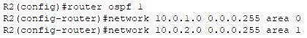
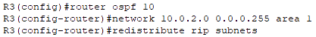
Advanced – OSPF Area Types
Area 0
Standard Area 1
External Network RIP
There are five types of OSPF area-
1.Backbone Area: The backbone area is area 0. It plays the role of the central node in the OSPF network and the link information of other areas is transmitted through area 0. This also means that all other areas must be connected to area 0. This area supports type 1, 2, 3, 4, and 5 LSAs.
G0/0/0
G0/0/0
G0/0/1
G0/0/0
G0/0/1
G0/0/0
R1
10.0.1.0/24
R2
10.0.2.0/24
R3
10.0.20.0/24
Ex-RTR
IR
BR
ASBR
G0/0/1
BR
Type 1/2
ABR
Type 1/2
10.0.21.0/24
Type 3
G0/0/0
Type 5
Type 4
Ex-RTR
2.Standard Area: A standard area is a non-backbone area. Standard areas can communicate with each other through the backbone area. A Standard Area has no specific characteristics. It help in optimizing routing as the information about all routes is with all routers. This area supports type 1, 2, 3, 4, and 5 LSAs.
0

Slide 41
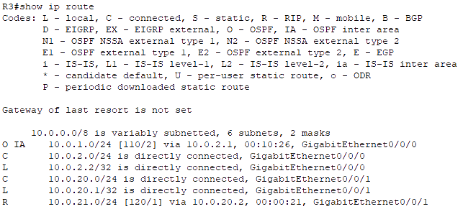
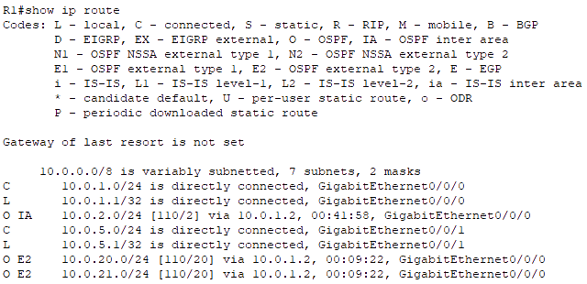
Advanced – OSPF Area Types
The following commands on the ASBRs of OSPF standard area-
‘Router(config)# router ospf <process ID>’
‘Router(config-router)# network <network IP> <wildcard mask> area <non zero area ID>’
‘Router(config-router)# redistribute <external routing protocols> subnets’

Slide 42
Advanced – OSPF Area Types
3.Stub Area: A stub area is a non-backbone area that only receives LSAs from the backbone area. Its is an optimization of standard area. Stub areas do not send LSAs to other areas and does not accept any external routes of non-OSPF network, if it wants to reach those external routes, only Need to send it through the default route. This area supports type 1, 2, and 3 LSAs. Stub area does not accept external routes(Type 5), it is replaced by default route.
Stub Area 2
Area 0
Standard Area 1
External Network RIP
External Network
G0/0/0
G0/0/1
G0/0/0
G0/0/0
G0/0/1
G0/0/0
G0/0/1
G0/0/0
R4
10.0.3.0/24
R1
10.0.1.0/24
R2
10.0.2.0/24
R3
10.0.20.0/24
Ex-RTR
ASBR
BR
BR
ASBR
G0/0/1
10.0.10.0/24
Type 1/2
ABR
Type 1/2
ABR
Type 1/2
10.0.21.0/24
10.0.11.0/24
Type 3
Type 3
Type 5
G0/0/0
Type 5
Default
Type 4
Ex-RTR

Slide 43
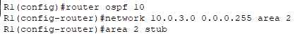
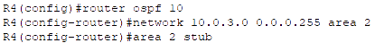
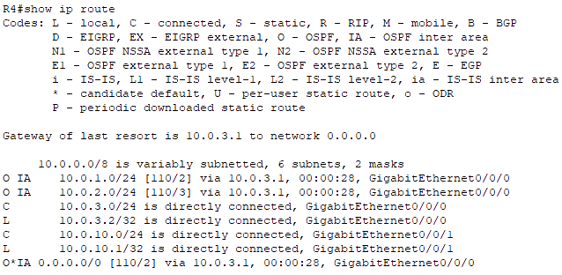
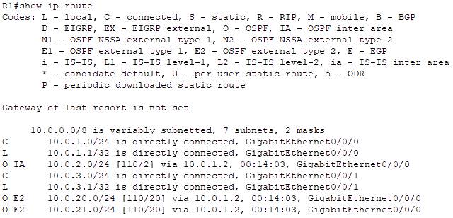
Advanced – OSPF Area Types
The following commands on routers of OSPF stub area-
‘Router(config)# router ospf <process ID>’
‘Router(config-router)# network <network IP> <wildcard mask> area <non zero area ID>’
‘Router(config-router)# area <non zero area ID> stub’

Slide 44
Advanced – OSPF Area Types
4.Totally Stubby Area: It is one step more strict Area than Stub Area. It means that the area does not accept external routes and does not accept the link information of other areas outside of their own area. This is a Cisco Proprietary OSPF Area. If it wants to reach the target network outside the area, it will send out the message through the default route just like the stub area. This area supports type 1, 2 and 3 LSAs with default routes.
Totally Stubby Area 3
Area 0
Standard Area 1
External Network RIP
External Network
G0/0/0
G0/0/1
G0/0/0
G0/0/0
G0/0/1
G0/0/0
G0/0/1
G0/0/0
R5
10.0.4.0/24
R1
10.0.1.0/24
R2
10.0.2.0/24
R3
10.0.20.0/24
Ex-RTR
ASBR
BR
BR
ASBR
G0/0/1
10.0.10.0/24
Type 1/2
ABR
Type 1/2
ABR
Type 1/2
10.0.21.0/24
10.0.11.0/24
Type 3
Type 5
G0/0/0
Type 5
Default
Type 4
Ex-RTR

Slide 45
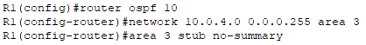
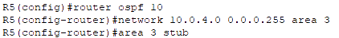
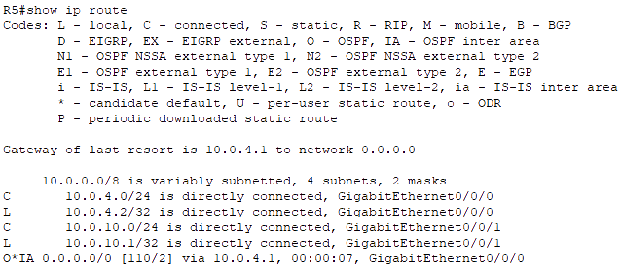
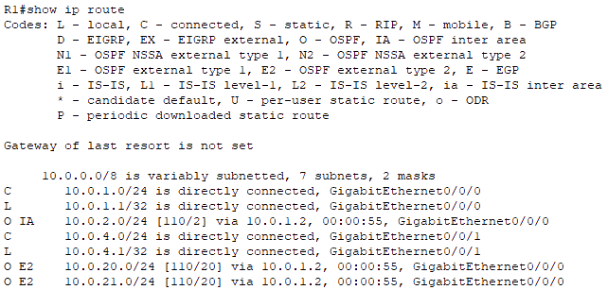
Advanced – OSPF Area Types
The following commands on the ABR of OSPF totally stubby area-
‘Router(config)# router ospf <process ID>’
‘Router(config-router)# network <network IP> <wildcard mask> area <non zero area ID>’
‘Router(config-router)# area <area no> stub no-summary’
And on other routers-
‘Router(config-router)# area <area no> stub’

Slide 46
Advanced – OSPF Area Types
5.Not So Stubby Area (NSSA): An NSSA is a non-backbone area that receives LSAs from the backbone area and from external networks. NSSAs do not send LSAs to other areas, but they can send LSAs to external networks. NSSAs are used when external routes need to be imported into OSPF while maintaining some area boundary restrictions. This area supports type 1, 2, 3, and 7 LSAs. Here type 7 LSAs are used which are similar to the type 5 LSA. Here the external links are advertised by the ASBR towards the ABR, which in turn will convert the LSA type 7 to LSA Type 5 and then flood it to the rest of OSPF network. Similar to other areas, type 1 and type 2 LSAs are used to build the topology tables. The type 3 LSAs are accepted by the NSSA thus can be used to reach other networks of other areas.
NSSA 3
Area 0
Standard Area 1
External Network RIP
External Network
G0/0/0
G0/0/1
G0/0/0
G0/0/0
G0/0/1
G0/0/0
G0/0/1
G0/0/0
R6
10.0.5.0/24
R1
10.0.1.0/24
R2
10.0.2.0/24
R3
10.0.20.0/24
Ex-RTR
ASBR
BR
BR
ASBR
G0/0/1
10.0.10.0/24
Type 1/2
ABR
Type 1/2
ABR
Type 1/2
10.0.21.0/24
10.0.11.0/24
Type 7
Type 5
Type 3
Type 5
G0/0/0
Type 4
Type 5
Default
Type 4
Ex-RTR

Slide 47
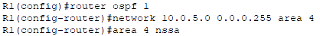
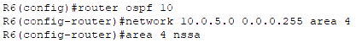
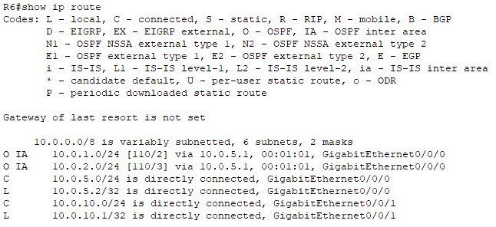
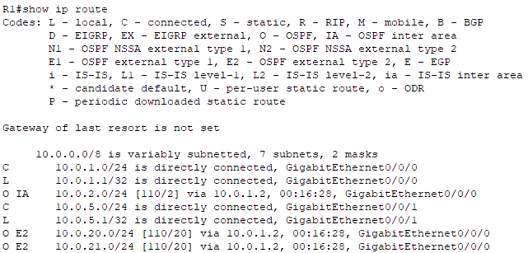
Advanced – OSPF Area Types
The following commands on routers of OSPF stub area-
‘Router(config)# router ospf <process ID>’
‘Router(config-router)# network <network IP> <wildcard mask> area <non zero area ID>’
‘Router(config-router)# area <non zero area ID> nssa’

Slide 48
Advanced – OSPF Virtual Link
Virtual links are used to connect a dis-contiguous area to area 0.
It is a logical connection built between routers.
To configure virtual link, firstly, identify the virtual area (standard area 1 in the following figure). Secondly, Identify the ABRs of virtual areas (R2 and R1 in the following figure). Thirdly, identify the router IDs of those ABRs. Stub or NSSA area doesn’t allow virtual link. Why?
R2-ID: 2.2.2.2
R3-ID: 3.3.3.3
Stub Area 2
Area 0
Standard Area 1
Standard Area 5
Standard Area 1
Standard Area 4
G0/0/0
G0/0/1
G0/0/0
G0/0/1
G0/0/0
G0/0/0
G0/0/1
G0/0/0
G0/0/1
G0/0/0
R9
10.0.6.0/24
R7
10.0.3.0/24
R1
10.0.1.0/24
R2
10.0.2.0/24
R3
10.0.5.0/24
R8
IR
ABR
BR
BR
ABR
IR
Type 1/2
Type 1/2
ABR
Type 1/2
ABR
Type 1/2
Type 1/2
Type 3
Type 3
Type 5
Default
Type 4

Slide 49


Advanced – OSPF Virtual Link
Commands of virtual link on the ABRs- ‘Router(config)# router ospf <process ID>’
‘Router(config-router)# area <virtual area ID> virtual-link <ABR ID>’

Slide 50

Advanced – OSPF Area (Network Engineer Pro)

Slide 51

Advanced – OSPF Area (Network Engineer Pro)

Slide 52



Advanced – LSDB Table

Slide 53
Advanced – OSPF Network Types
There are two more types of OSPF network-
OSPF
4. P2MP (Point to Multipoint)
5. P2MP Non Broadcast
A point-to-multipoint (P2MP) OSPF network is a network where one router is connected to multiple other routers. This type of network is typically used for Frame Relay and ATM networks.
P2MP NBMA OSPF network type is used where OSPF routers are connected via NBMA networks, such as Frame Relay or X.25, and need to communicate with multiple neighbors over the same network segment.

Slide 54
Advanced – Point-to-Multipoint Network
Spoke
P2MP networks are similar to P2P networks, but they support multiple remote routers connecting to a central router. The remote routers are not directly connected to each other.
Typically used in wireless or hub-and-spoke topologies.
The hub router maintains a separate OSPF adjacency with each of the remote routers.
Spoke routers establish OSPF adjacencies with the hub router but do not establish adjacencies with each other.
Adjacencies are established between all neighboring routers. There is no DR/BDR concept.
These type of network are not seen in LAN networks. They are commonly used in WAN scenarios such as: Remote site connectivity, branch office connectivity, wireless mesh networks and many more.
Hub
Spoke
WAN
Spoke
Full mesh WAN deployment are rare and generally not recommended.
Interfaces connecting Hub and Spoke will be in same subnet just like a OSPF broadcast network connected with a switch.

Slide 55
Advanced – OSPF Network Type Differences
Network Type | P2P | Broadcast | NBMA | P2MP | P2MP NB
Max Routers per Link | 2 | ∞ | ∞ | ∞ | ∞
Full Mesh Connectivity Assumed | Yes | Yes | Yes | No | No
DR/BDR Election | No | Yes | Yes | No | No
Hello/Dead Timer (Cisco Default) | 10 / 40 | 10 / 40 | 30 / 120 | 30 / 120 | 30 / 120
Automatic Neighbor Discovery | Yes | Yes | No | Yes | No
Discovery & Periodic Hello sent to | 224.0.0.5 | 224.0.0.5 | Neighbor IP | 224.0.0.5 | Neighbor IP
Neighbor Communication sent to | 224.0.0.5 | Unicast | Unicast | Unicast | Unicast
LSA(s) sent to | 224.0.0.5 | Multicast DR/BDR | Unicast DR/BDR | Unicast | Unicast
Next-Hot IP | Peer | Originated Router | Originated Router | Hub | Hub

Slide 56
Advanced – OSPFv2 Authentication
Authentication is used to prevent unauthorized or invalid routing updates in the network.
According to RFC 2328 (Arpril, 1998), there are three different types of authentication available for OSPF version 2: Type 0 - Null authentication: Null authentication means that there is no authentication, which is the default on Cisco routers. Type 1 - Clear text authentication: In this method of authentication, passwords are exchanged in clear text on the network Type 2 - Cryptographic authentication: The cryptographic method uses the open standard MD5 (Message Digest type 5) encryption.
The authentication type can be configured at the area level or at the interface level.
In either case, the password must still be configured at the interface level.
If both are configured, interface level configuration overrides area level configuration.
Clear Text (maximum 8 characters) Authentication is configured when devices within an area cannot support MD5 Authentication. It leaves the internetwork vulnerable to a "sniffer attack" — where packets are captured by a protocol analyzer and the passwords can be identified.
MD5 authentication provides higher security. This method uses the MD5 algorithm to compute a hash value from the contents of the OSPF packet and a password (or key). The hash value is transmitted in the packet, along with a key ID and a non-decreasing sequence number. The receiver, which knows the same password, calculates its own hash value. If nothing in the message changes, the hash value of the receiver should match the hash value of the sender which is transmitted with the message. The key ID allows the routers to reference multiple passwords. This makes password migration easier and more secure.

Slide 57

Advanced – OSPFv2 Authentication Type 1 (Clear Text)
Area based clear text authentication commands- ‘Router(config)# interface <interface name>’ ‘Router(config-if)# ip ospf authentication-key <key value>’ ‘Router(config-if)# exit’ ‘Router(config)# router ospf <process ID>’ ‘Router(config-router)# area <area ID> authentication’ ‘Router(config-if)# exit’
Interface based clear text authentication commands- ‘Router(config)# interface <interface name>’ ‘Router(config-if)# ip ospf authentication’ ‘Router(config-if)# ip ospf authentication-key <key value>’ ‘Router(config-if)# exit’

Slide 58

Advanced – OSPFv2 Authentication Type 2 (Cryptographic – MD5)
Area based cryptographic MD5 authentication commands- ‘Router(config)# interface <interface name>’ ‘Router(config-if)# ip ospf message-digest-key <key num> md5 <key value>’ ‘Router(config-if)# exit’ ‘Router(config)# router ospf <process ID>’ ‘Router(config-router)# area <area ID> authentication message-digest’ ‘Router(config-if)# exit’
Interface based cryptographic MD5 authentication commands- ‘Router(config)# interface <interface name>’ ‘Router(config-if)# ip ospf authentication message-digest’ ‘Router(config-if)# ip ospf message-digest-key <key num> md5 <key value>’ ‘Router(config-if)# exit’

Slide 59

Advanced – OSPFv2 Authentication Type 3 (Cryptographic – SHA)
After being compromised, RFC 5709 (October, 2009) allows OSPF to use HMAC-SHA algorithms for cryptographic authentication.
With the addition of SHA to type 2 authentication, it is now called cryptographic authentication for both MD5 and SHA.
It is similar to MD5 but more secure.
This is only available at the interface level & it uses key chains
Interface based cryptographic SHA authentication commands- ‘Router(config)# key chain <chain name>’ ‘Router(config-keychain)# key <key num>’ ‘Router(config-keychain-key)# key-string <string>’ ‘Router(config-keychain-key)# cryptographic-algorithm hmac-sha-256’ ‘Router(config-keychain-key)# exit’ ‘Router(config-keychain)# exit’ ‘Router(config)# interface <interface name>’ ‘Router(config-if)# ip ospf authentication key-chain <chain name>’ ‘Router(config-if)# exit’
Key identifier range will be <1-255>

Slide 60

Advanced – OSPFv2 Authentication Type 3 (Cryptographic – SHA)
The currently valid algorithms for OSFv2 Cryptographic Authentication include:
Keyed-MD5 (defined in RFC 2328)
HMAC-SHA-1 (defined in RFC 5709)
HMAC-SHA-256 (defined in RFC 5709)
HMAC-SHA-384 (defined in RFC 5709)
HMAC-SHA-512 (defined in RFC 5709)
HMAC stands for Hashed Message Authentication Code.
SHA stands for Secure Hash Algorithm.
Sending SA: Status of sending Security Association. Key, Cryptographic Algorithm and Key Chain used.

Slide 61
Advanced – OSPFv3 Basic
OSPFv3 is based on OSPFv2 with enhancement.
It distributes IPv6 prefixes and runs directly over IPv6.
It adds IPv6 specific attributes like-
128 bit addresses.
Link-local address.
Multiple addresses and instances per interface.
Authentication (now uses IPsec).
OSPFv3 runs over a link, rather than a subnet.
IPv6 routing has to be enabled before using any routing process as by default IPV6 routing is disabled.
Router-ID in OSPFv3 must be in IPv4 format. If any loopback or physical interfaces in the router doesn’t have any IPv4 address, OSPFv3 cannot be configured without manually configuring its Router-ID manually in IPv4 format.
Commands for OSPFv3- ‘Router(config)# ipv6 unicast-routing’ ‘Router(config)# ipv6 router ospf <process ID>’ ‘Router(config-rtr)# router-id <router ID>’ ‘Router(config-rtr)# exit’ ‘Router(config)# interface <interface name>’ ‘Router(config-if)# ipv6 enable’ ‘Router(config-if)# ipv6 router <process ID> area <area ID>’ ‘Router(config-if)# end’ ‘Router# show ipv6 protocols’ ‘Router# show ipv6 ospf neighbor’

Slide 62


Advanced – OSPFv3 Basic

Slide 63


PDU – Packet Type 1 (Hello)
Notes:
NBMA: It refers to a type of network topology or technology commonly found in computer networking. In an NBMA network, multiple devices or nodes are connected to a common network segment or medium, but unlike a broadcast network (such as Ethernet), NBMA networks do not support the automatic broadcasting of data to all nodes on the network. Instead, communication in an NBMA network typically requires explicit addressing.

Slide 64


PDU – Packet Type 2 (DD)

Slide 65


PDU – Packet Type 3 (LSR) & Type 4 (LSU)

Slide 66

PDU – OSPF Router LSA

Slide 67


PDU – OSPF Network LSA

Slide 68


PDU – Packet Type 5 (LSAck)

Slide 69




Thank You
Feel free to reach out to me for any suggestions or feedback via LinkedIn or Mail
www.github.com/smsufi
www.linkedin.com/in/smsufi
safwanm.cse@gmail.com

Slide 70
OSPF – References
https://en.wikipedia.org/wiki/Open_Shortest_Path_First
https://www.youtube.com/@SIKANDARshaik/playlists
https://www.youtube.com/@kushalkabi/playlists
https://www.youtube.com/@Certbros/playlists
https://www.geeksforgeeks.org/open-shortest-path-first-ospf-protocol-states/
https://www.cisco.com/c/en/us/support/docs/ip/open-shortest-path-first-ospf/7039-1.html
https://study-ccna.com/ospf-overview/
https://networklessons.com/ospf/basic-ospf-configuration
https://www.javatpoint.com/ospf-protocol
https://www.techtarget.com/searchnetworking/definition/HELLO-packet#:~:text=A%20HELLO%20packet%20is%20a,First%20(OSPF)%20communications%20protocol.
https://www.n-study.com/en/ospf-detail/ospf-hello/
https://techhub.hpe.com/eginfolib/networking/docs/switches/5500hi/5998-5330_l3-ip-rtng_cg/content/351988006.htm#279688693
https://www.n-study.com/en/ospf-detail/ospf-packet/

Slide 71
OSPF – References
https://www.n-study.com/en/ospf-detail/ospf-lsa-type/
https://community.cisco.com/t5/switching/ospf-process-id/td-p/1405396
https://www.quora.com/What-is-the-purpose-of-OSPF-process-ID
https://www.youtube.com/@PracticalNetworking/playlists
https://www.router-switch.com/faq/five-ospf-area-types.html#:~:text=There%20are%20five%20types%20of,so%20stubby%20area%20(NSSA)
https://www.geeksforgeeks.org/ospf-area-types/
https://ipwithease.com/ospf-area-types/
https://ipcisco.com/lesson/ospf-area-types-ccnp/
https://www.youtube.com/@JeremysITLab/playlists
https://www.youtube.com/watch?v=m2M9akEsJao
https://community.cisco.com/t5/networking-knowledge-base/ospf-authentication/ta-p/3131640
https://info.pivitglobal.com/resources/configuring-ospf-authentication
https://www.cisco.com/c/en/us/td/docs/ios-xml/ios/iproute_ospf/configuration/xe-3s/iro-xe-3s-book/iro-ospfv2-crypto-authen-xe.html

Slide 72
OSPF – References
RFC 2328 - OSPF Version 2 (RFC2328) (faqs.org)
http://www.faqs.org/rfcs/rfc5709.html
https://support.huawei.com/enterprise/en/doc/EDOC1100278245/6cac587/understanding-ospfv3-authentication
https://www.arubanetworks.com/techdocs/AOS-CX/10.07/HTML/5200-7857/Content/Chp_OSPFv3/OSPFv3_cmds/ipv-osp-aut-ips-osp-10.htm
https://networklessons.com/ipv6/ospfv3-authentication-and-encryption

